Slide 1
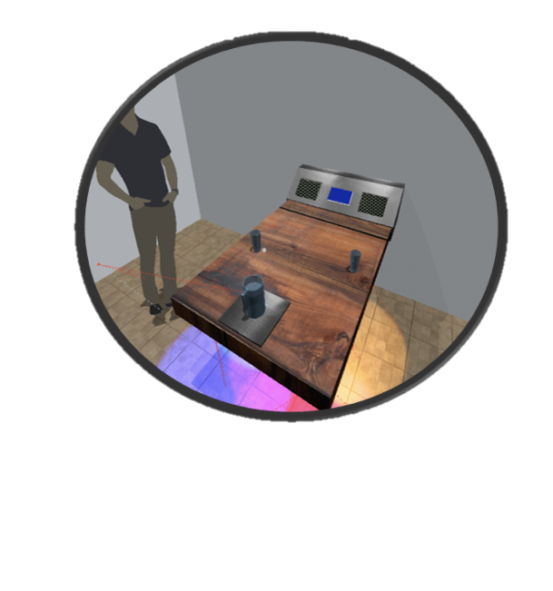
Smart Table
Critical Design Review
Group 16
Christopher Corley
Theodore Cox
Dhaval Desai
Mikey Garrity

Slide 2
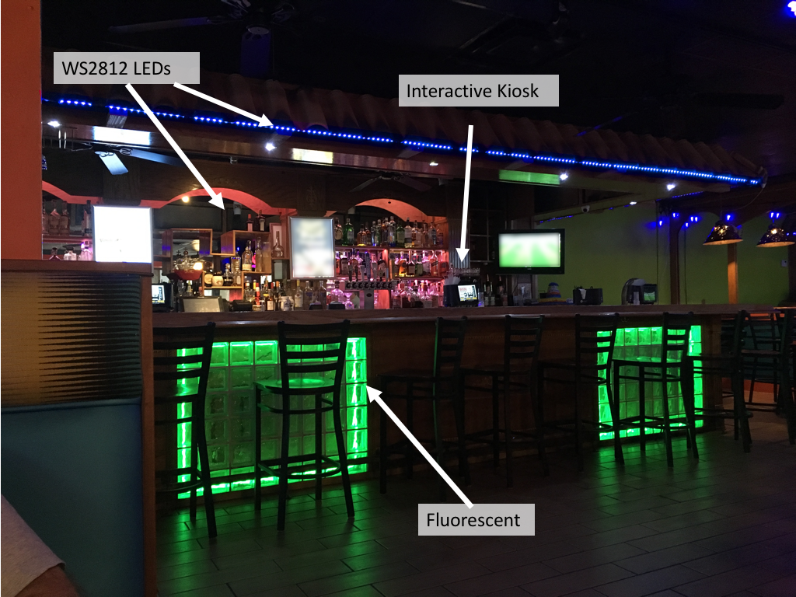
Inspiration
Kiosks, Fancy LEDs, IOT… these things exist in restaurants but not in a unified way
Flagging the waiter for help can be awkward, and can ruin the dining experience
Desire to integrate smart technologies into one PCB and package
M

Slide 3
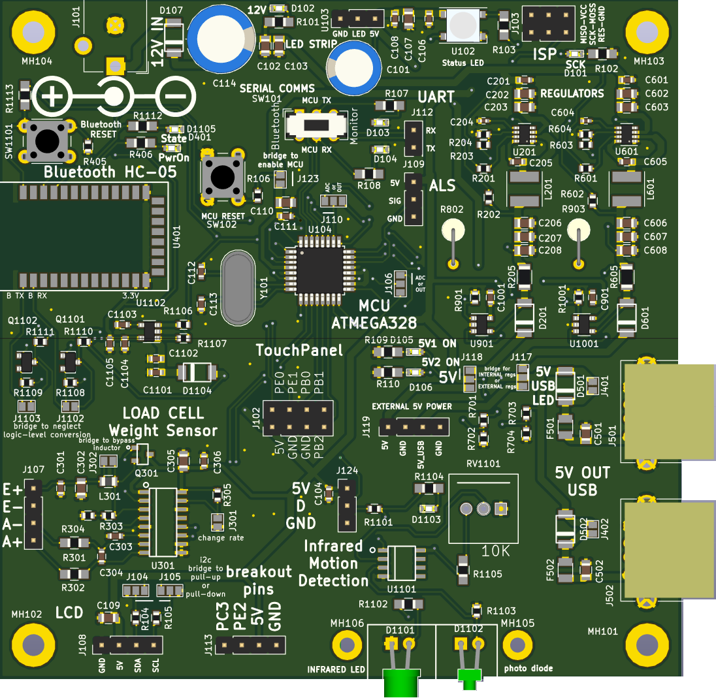
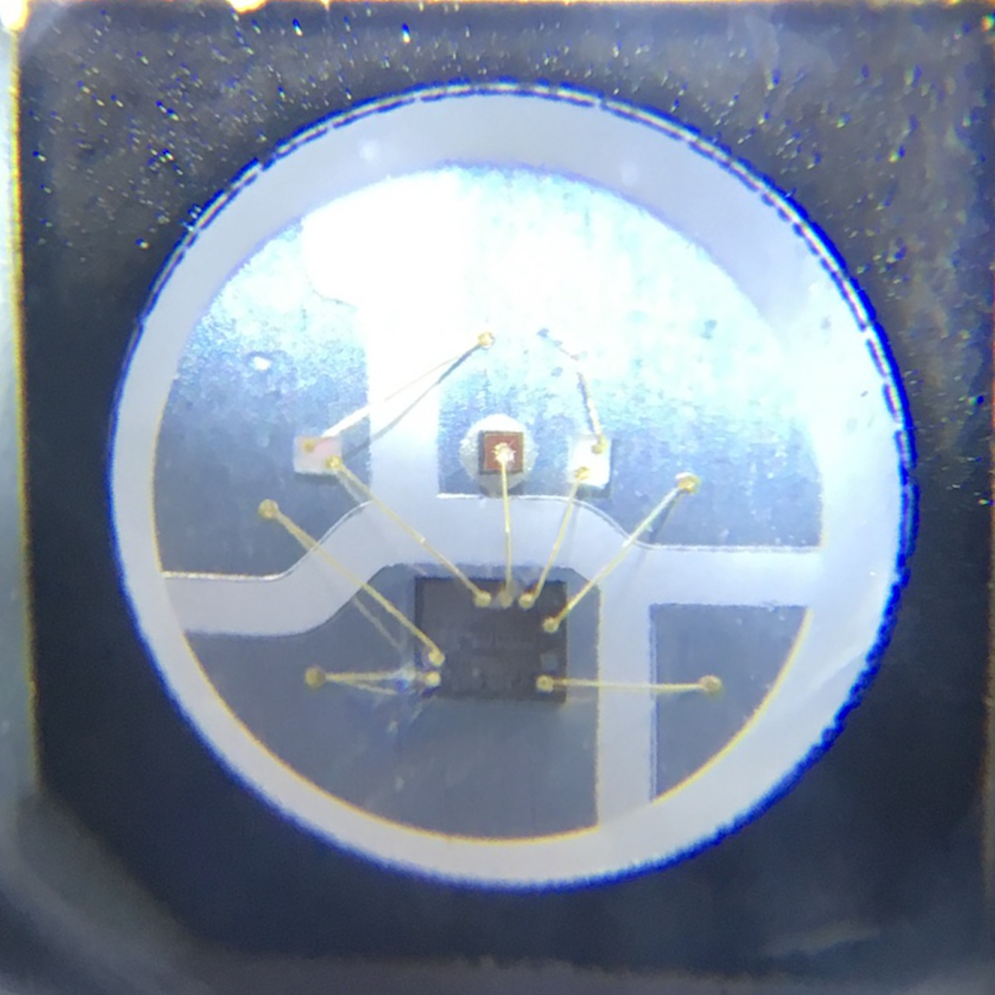
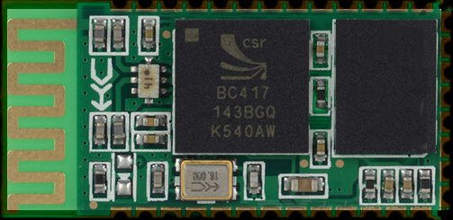
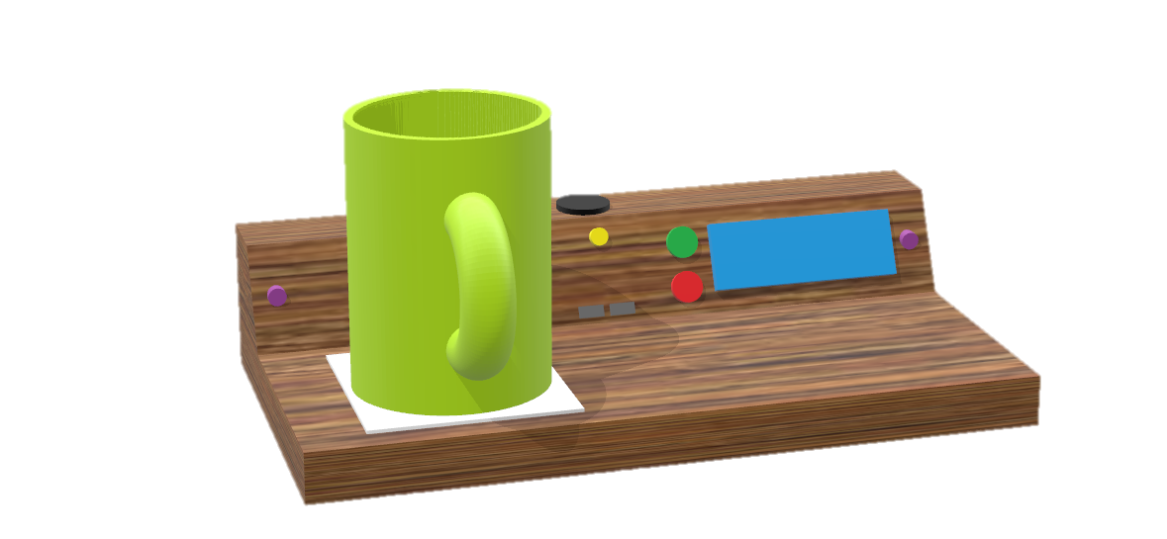
Solution
We propose a “smart table” that will integrate cool technology into restaurants with a custom designed PCB and housing.
M
Notes:
More and more restaurants are making the move toward integrating smart technology into the dining experience. By integrating technology into restaurants, the guest experience can be enhanced, while giving restaurant staff more efficient tools to serve them. The smart table project bundles an array of sensors and electronics that will be placed as a kiosk on the end of a restaurant table. Its features include detection of the guests when they are seated, RGB mood lighting with adaptive brightness, a call server button via a restaurant staff mobile application, the ability to detect when your drinks are empty, and more. This project will be easily integrated into any restaurant and will be cost effective, opening the doors for restaurants around the world to introducing tech into the dining experience.

Slide 4
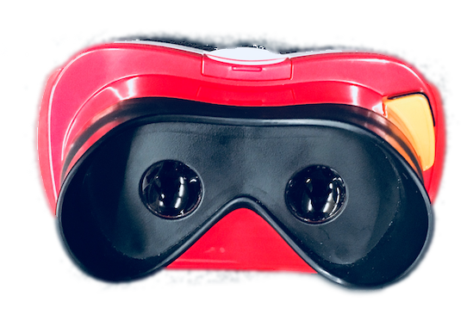
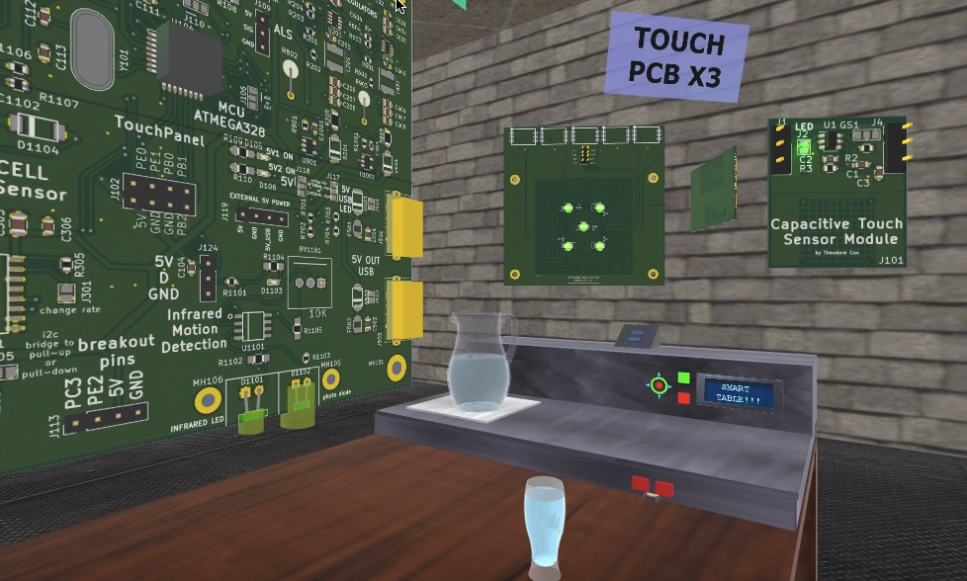
VR Demo
We will be passing around a VR headset that will let you look inside our smart table and view our various PCBs
Use the orange button on the headset to toggle X-ray vision on/off
M

Slide 5
Requirements Specifications
The table shall be illuminated in at least 2 distinct patterns.
The table shall use a load cell sensor to detect that a beverage pitcher is empty.
The printed circuit board design shall have regulators that support 5V and 3.3V sensors.
The total cost of the system shall not exceed $600.
The lighting on the table shall emit at least 200 lumens.
The system shall use less than 15 watts of peak power.
The table shall recognize when a server visits via a mobile application system.
The table shall communicate with server from a distance of at least 20 feet.
The lighting brightness on the table shall be adjustable based on the input of photocell sensor.
D

Slide 6
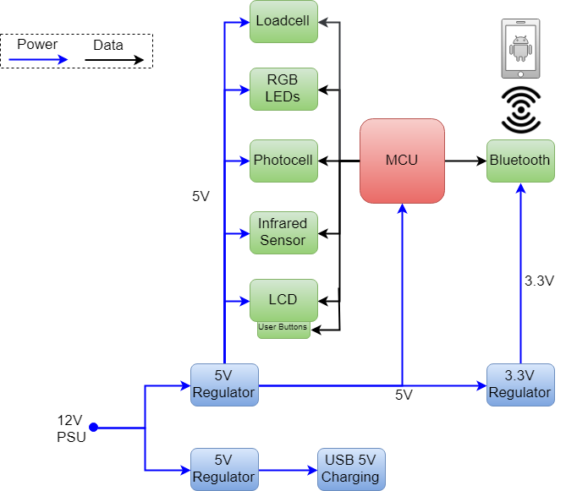
High Level System Block Diagram
D
Notes:
Need to update figure to reflect current design. ex: motion detection is on the PCB now

Slide 7
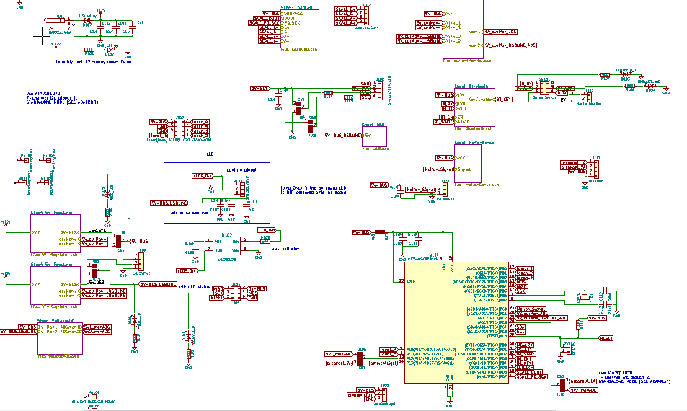
High Level Schematic Diagram
D

Slide 8
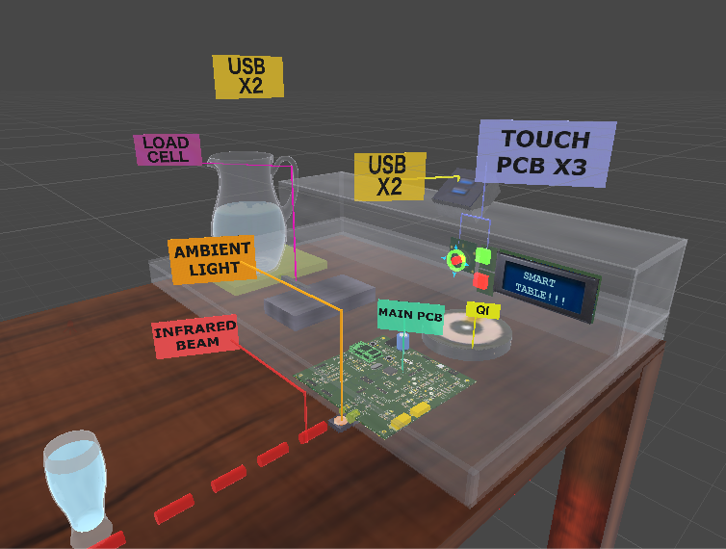
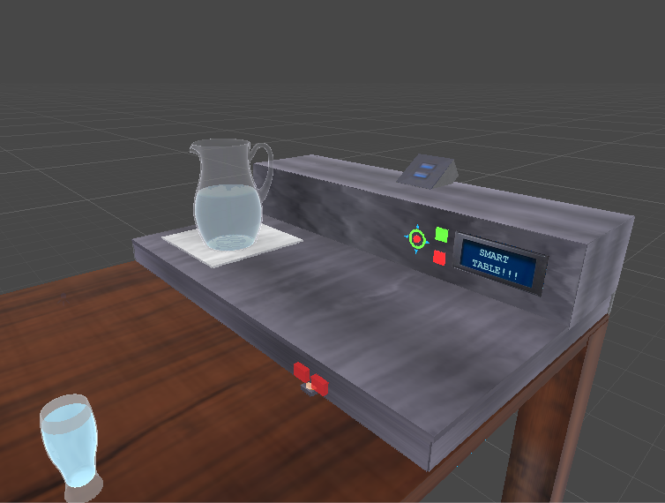
3D Render
D
Notes:
This is not a exact replica of the dimensions.

Slide 9
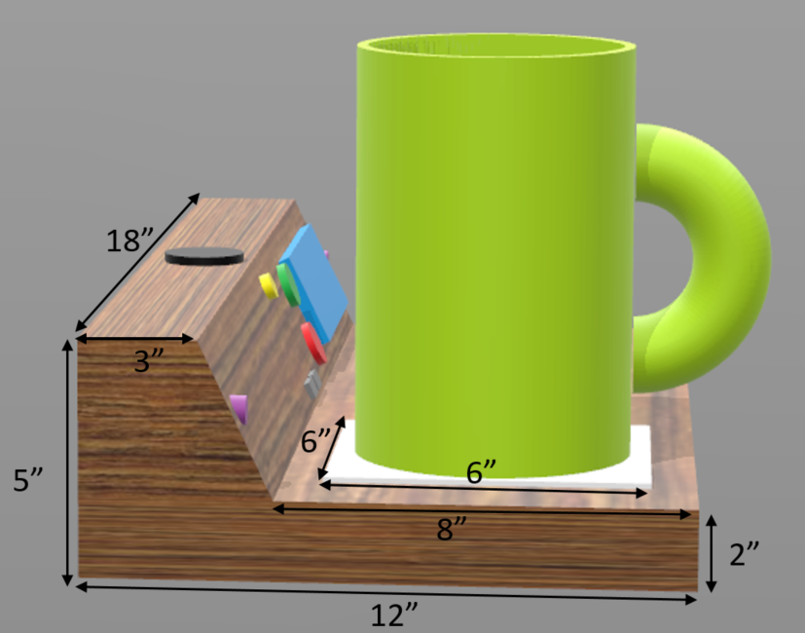
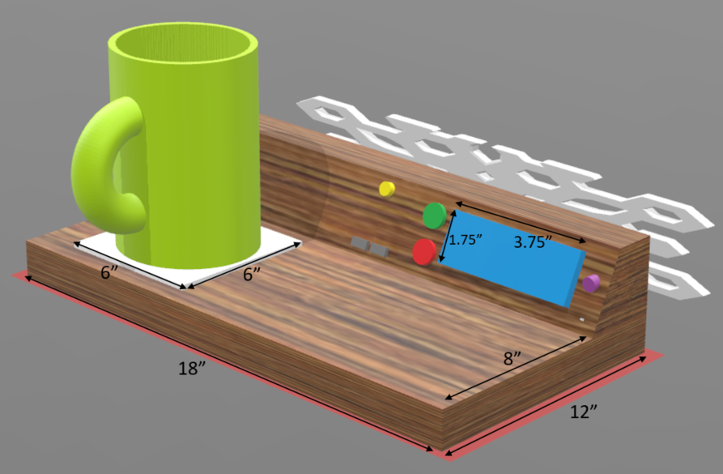
Dimensions
Designed the dimensions according to certain considerations:
Will have room to facilitate an average size beverage pitcher
Minimizes dead space in the box
Small enough to fit on any restaurant table
C

Slide 10
Subsystem Overview
M

Slide 11
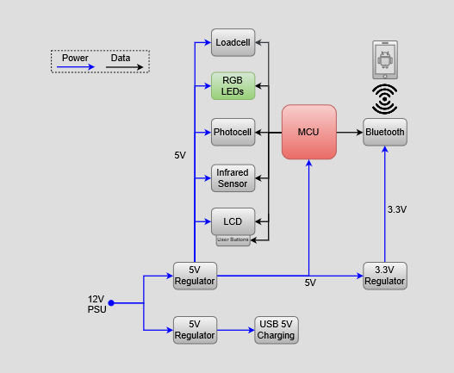
Smart LED Subsystem
M

Slide 12
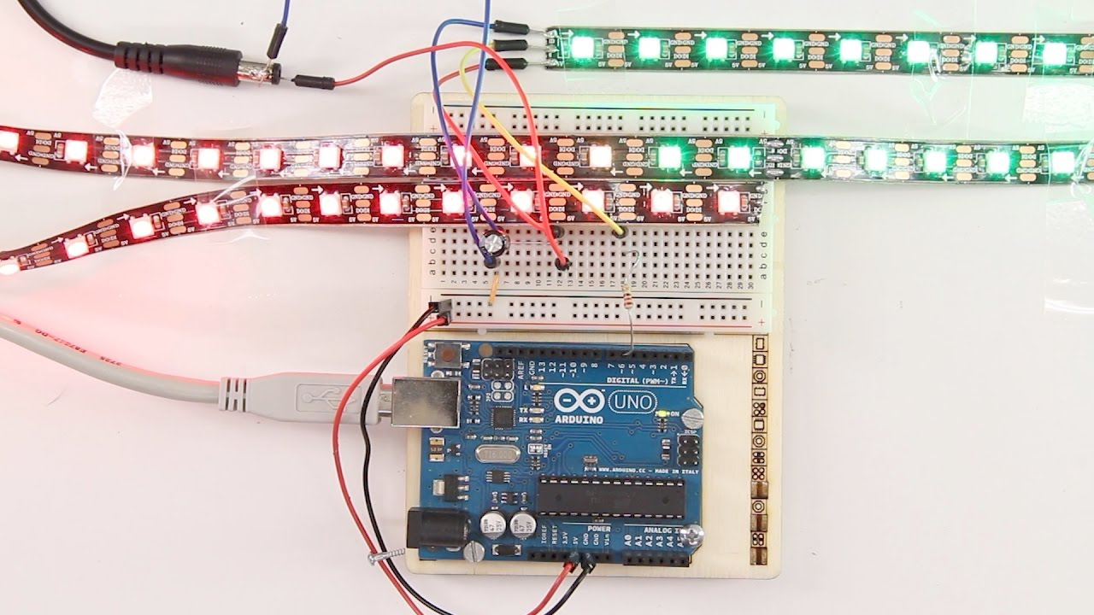
Smart LED Subsystem Intro
Used to Signal Waiters
Examples:
If guest needs immediate attention (Red)
When guests are happy (Blue)
Provide ambient light
M

Slide 13

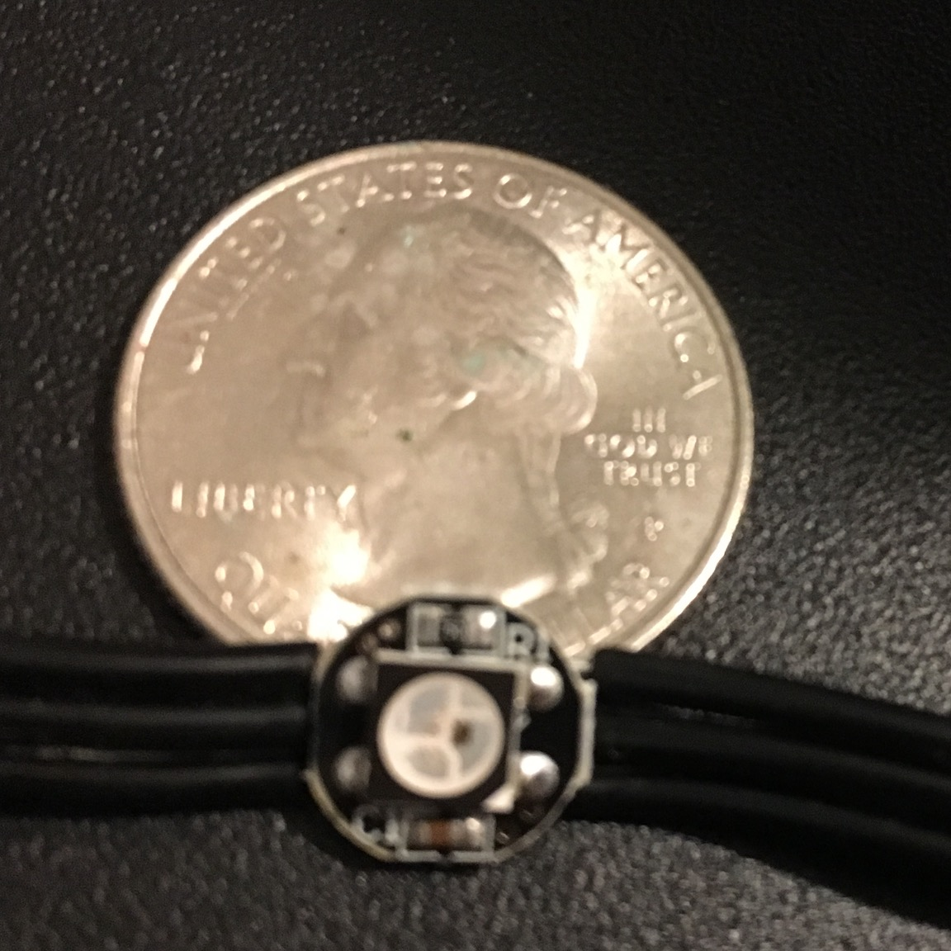
Smart LEDs
WS2812B- Modern 5V equivalent of addressable LEDs (12V)
1 Data Line- Internal Clock (persnickety about timing)
High Draw: 1-2 Amps Oscillating
RGB LEDs
IC (Clock)
M

Slide 14
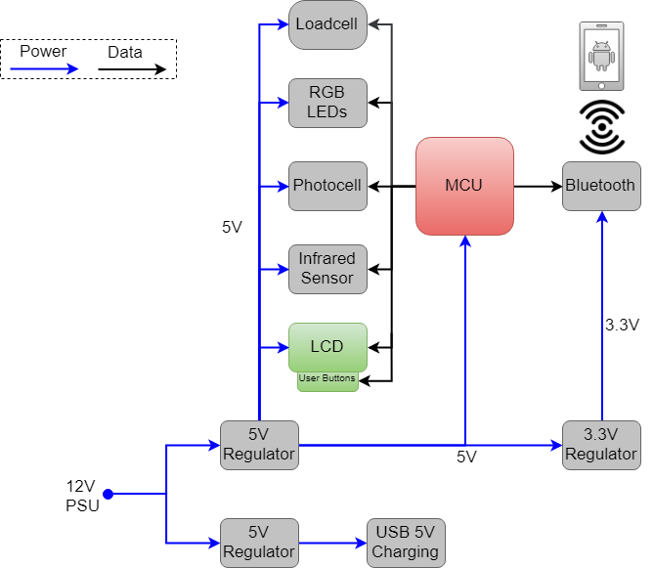
Information Display Highlighted
C
Notes:
Need to update figure to reflect current design. ex: motion detection is on the PCB now

Slide 15
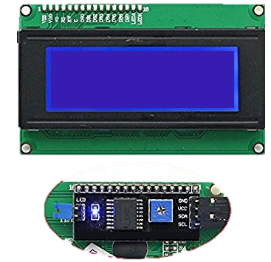
Information Display
Provides the ability to present text strings to the tables guests using the LCD screen
“Welcome, your server will be with you shortly.”
“Would you like a beverage refill?” Yes or No
Uses a custom designed capactive touch board to allow the guests to respond to questions on the screen
Smraza 2004 LCD Module
Welcome, your server will be with you shortly.
C

Slide 16
Information Display PCB Topology
C

Slide 17
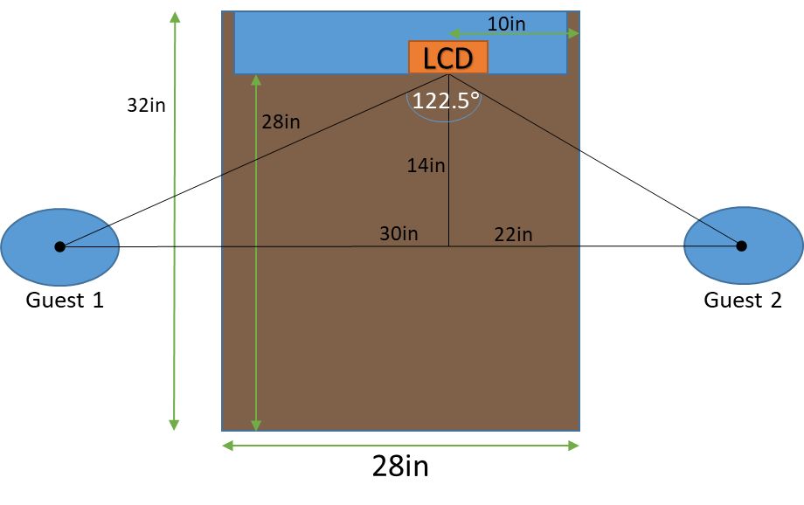

Viewing Angle Analysis
Some screen technology types have very poor viewing angles
Geometric analysis that shows the necessary viewing angles of the screen
122.5$°$ viewing angle or greater will be adequate for both guests to clearly see the text on the information display
C

Slide 18
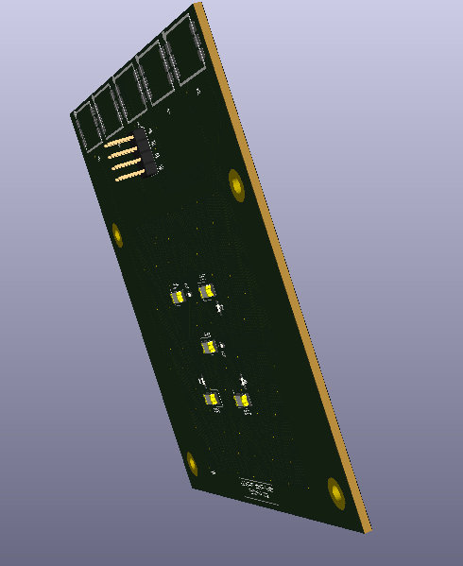


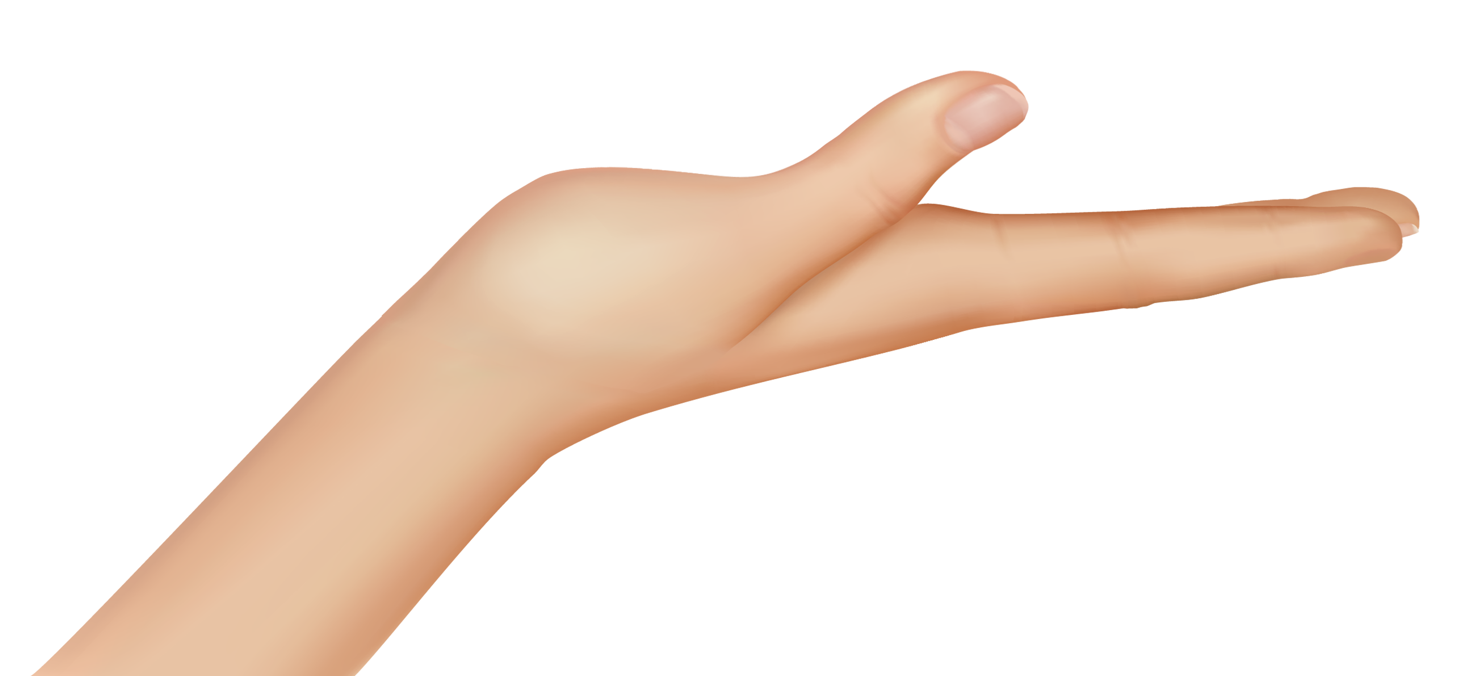
Capactive Touch Board Introduction
Designed a capactive touch PCB board
Allows users to interact with the smart table
Will be used for Yes / No questions and calling the server
Can be expanded to provide further user I/O in the future if desired
More water resilient than tradition push buttons
Also allows for a flush flat surface
Reverse Gull Wing LEDs utilized: They allow the LED’s light to emit through the board
T

Slide 19
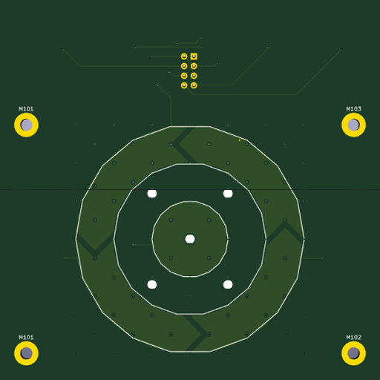
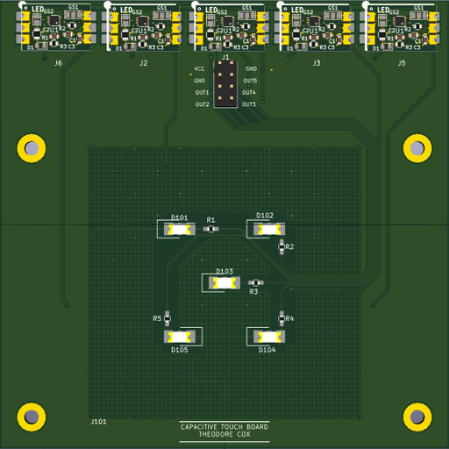
Capacitive Touch Panel Board PCB
T

Slide 20
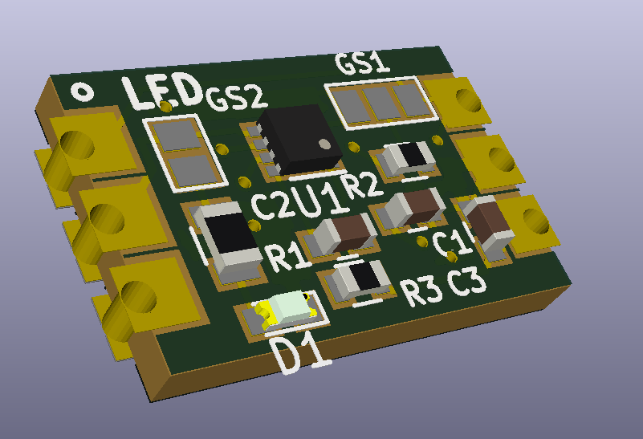
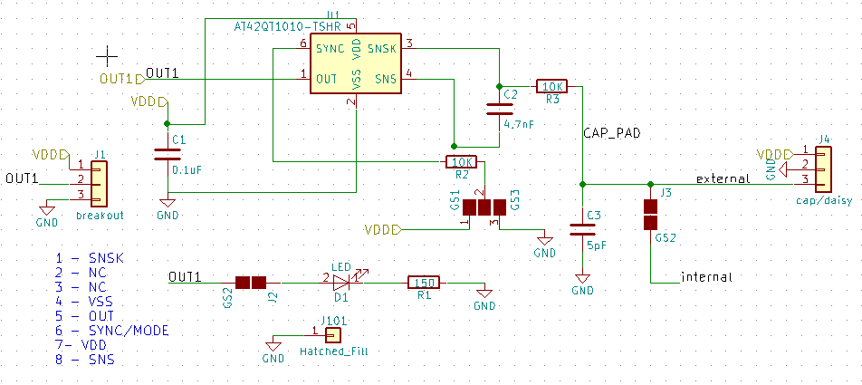
Capacitive Touch Driver Board Schematic
The Capactive Touch Panel board consists of 5 smaller driver boards (with castellated holes) custom designed using Microchip’s AT42QT1010-TSHR
T

Slide 21
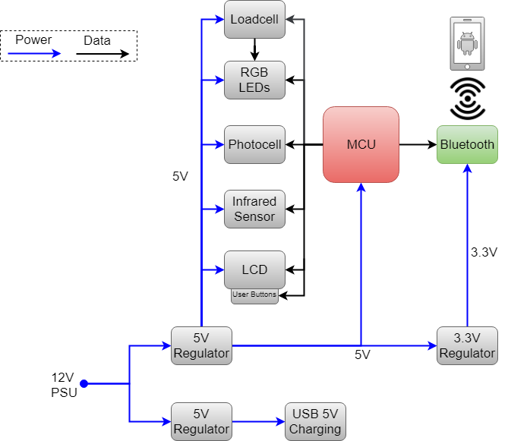
Bluetooth Subsystem Highlighted
C

Slide 22
Waiter–Table Bluetooth Communication
Using HC-05 Bluetooth 2.0 module for wireless communication
Works in tandem with the mobile applications and other sensors to provide information to the server
Had to incorporate dedicated LDO regulator to drop from 5V to 3.3V for the Vcc on the Bluetooth module
Uses logic level shifter to drop logic voltage from 5V to 3.3V
C

Slide 23
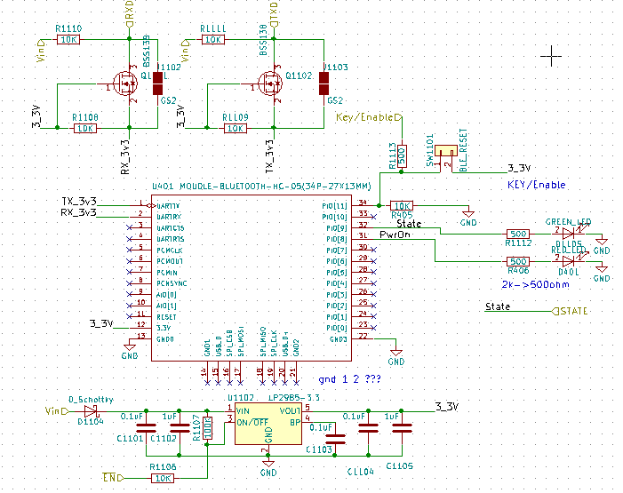
Bluetooth Schematic
C

Slide 24
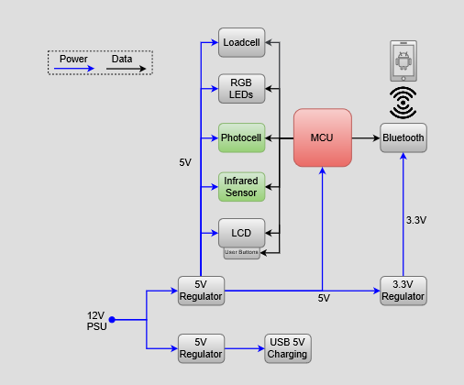
Motion Detection and Adaptive Brightness
D

Slide 25
Motion Detection with Infrared Sensor
Using an infrared emitter and receiver we will detect when guests are sitting at the table
When guests are seated according to sensor, the software routine will turn on the tables ambient lighting LEDs and notify the server that guests have arrived
If no movement is detect for a set period of time the lighting on the table will be turned off to save energy
Tested the prototype using Sharp GP2Y0A21YK0F sensor which can sense up to 80 cm
D

Slide 26
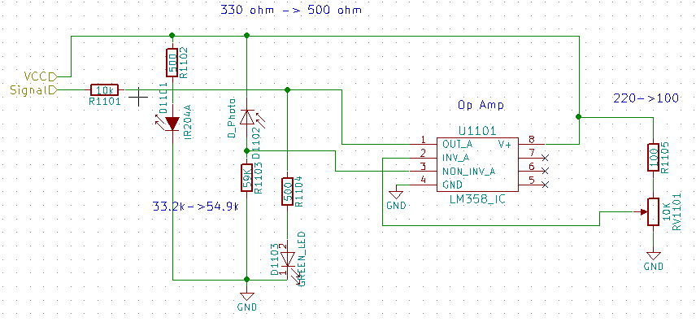
Infrared Sensor Schematic
D

Slide 27
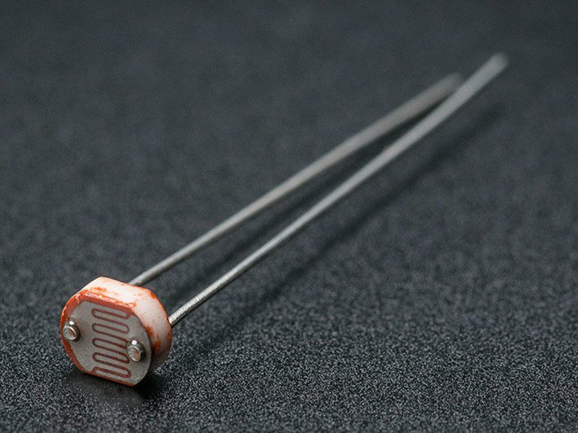
Photocell Sensor
Photocell sensor will determine how bright the area is around the table
This information will allow us to tweak the relative brightness of the signal LEDs intelligently
Tested the subsystem using photocell sensor designed by DFRobot (DFR0026) which can sense up to 6000 Lux in less than 15us.
D

Slide 28
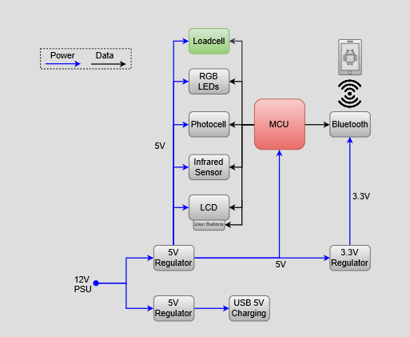
Loadcell / Beverage Tracking Block Diagram
T

Slide 29
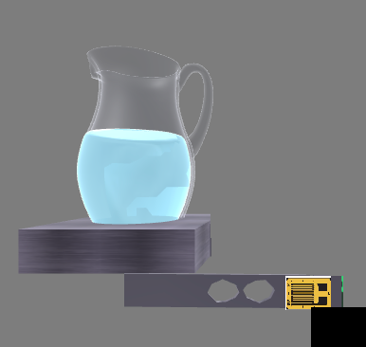
Beverage Tracking
Uses a loadcell and an amplification circuit to detect the weight of the beverage pitcher
Once the value reaches a certain threshold software will notify the server via the mobile application
The guests will be prompted on the LCD if they would like a refill
Uses HX711 loadcell amplifier IC to increase the output voltage from the Wheatstone bridge
T

Slide 30
Loadcell PCB Topology
T

Slide 31
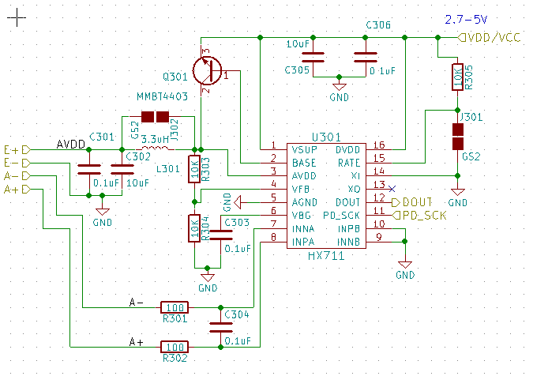
Load Cell Schematic
T

Slide 32
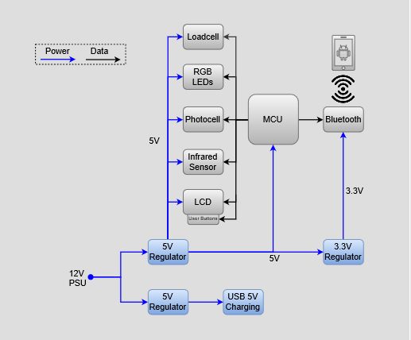
System Power Delivery Block Diagram
T

Slide 33
System Power Delivery
PCB Input Voltage 12
In board Regulators
Two 5V Switching (Buck) Step-Down
One 3.3V LDO
PCB features thicker power line traces 40mils ( low impedance)
PCB features reverse voltage prevention for 12V (series diode)
USB 5V OUT
Current Monitoring sub-circuit
T

Slide 34
System Power Delivery PCB Topology
12V IN
5V OUT
3.3V OUT
T

Slide 35
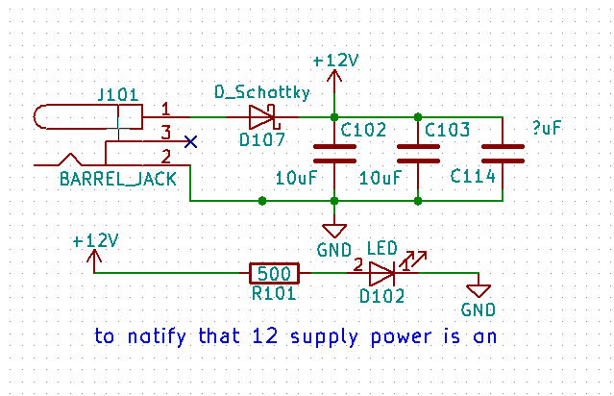
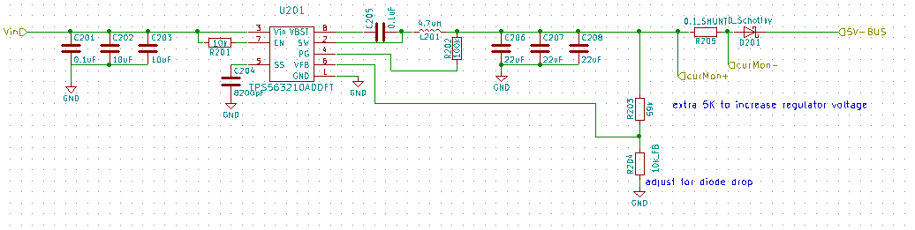
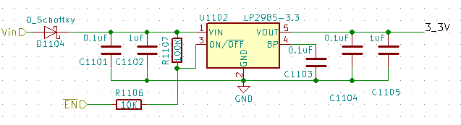
System Power Delivery Schematic
12V IN
5V OUT
3.3V OUT
T

Slide 36
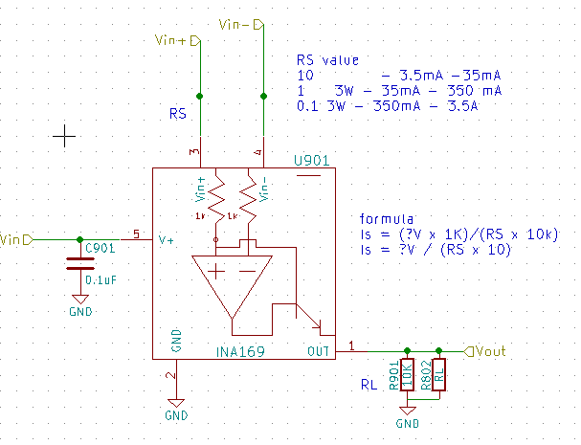
System Current Monitor Schematic
Uses a shunt resistor (low impedance with high power rating)
Op - amp uses the differential voltages of both sides of the resistor and outputs a analog signal.
With the formula provided in the schematic we can derive the current from the output of the regulators.
T

Slide 37
Mobile Application
C

Slide 38
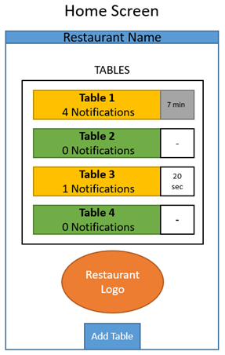
Mobile Application Home Screen
The mobile application will be designed so that the server can receive notifications from the guests at the table
The app with include a list of tables that they are currently connected to
The screenshot depicts what the server will see on the home screen of the application
C

Slide 39
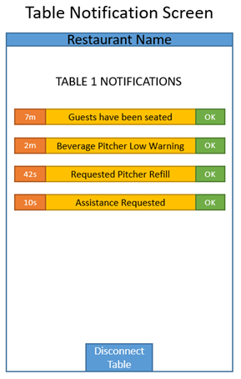
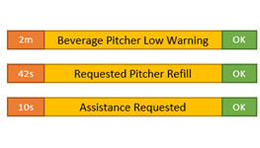
Mobile Application Table Notifications
Once inside the table screen the server can see a list of notifications
Some of these are automatically sent from the table, like the “Beverage Pitcher Low Warning”
Other notifications are directly sent from the guest, like when the guest clicks the request server button
The server can see how long the notifications have been present, and dismiss them with the OK button
C

Slide 40
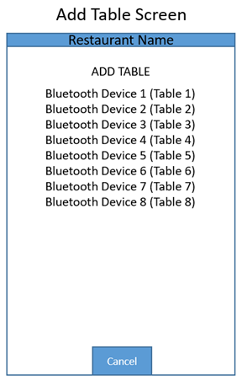
Mobile Application Home Screen
Clicking on the Add Table button the server can connect to a new table
The Add Table screen shows a list of all smart tables in the area
Clicking a device will add the table to the home screen so the server can begin receiving notifications
C

Slide 41
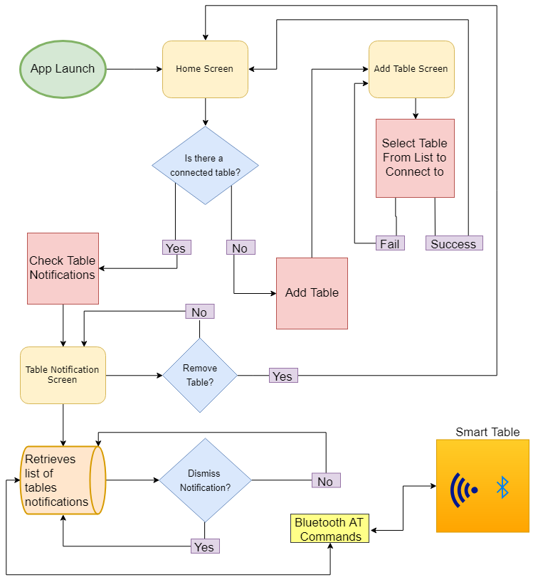
Mobile Application Flow Chart
C

Slide 42

Android vs iPhone
Side Loading Developer Apps
Android Free
Apple “MFi Verified Bluetooth”
Xcode / iOS updates constant
M

Slide 43
Design Rationale
M

Slide 44
Decisions: MCU
Prototyped with Atmel ATmega2560
50 No Connect Data Pins (2560)
$15 v $1
1 v 2 UART
ISP v USB
# pins to solder
3 analog pins (+2 on new 328-PB)
Bootloaders
MCU (ATmega) | Analog Pins | Digital Pins | UART
2560 | 8 | 50 | 4
328-P | 6 | 14 | 1
328-PB | 8 | 18 | 2
M

Slide 45
Decisions: MCU / Subsystem Voltages
Prototyped with 5V (exception BT)
PCB version 1 was 3.3V
Most components logic high of 3.3 V or less.
WS2812B LEDs required 5V and 16 MHz CPU
3.3 V = Down-clocked to 8MHz… (sold as special package), 16 MHz = brownout
Went with 5V and LL-shifter for BT
M

Slide 46
Decisions: Which LCD Type?
Considered TFT LCD but needs more robust hardware to drive pixels
OLED looks nice but is more expensive, also life expectancy is lower
LED Matrix was too big and not high enough resolution
Realization that a simple character display was plenty adequate
 | TFT LCD | OLED | LED Matrix | Character LCD
Cost | $49.99 | $23.15 | $24.95 | $14.99
Pixel Resolution | 480x272 Pixels | 4x20 Characters | 16x32 LED Matrix | 4x20 Characters
Viewing Area | 4.3” Diagonal | 3” x 1” | 7.6” x 3.8” | 3” x 1”
Durability | Average | Low | Low | High
Life Expectancy | ~100,000 hr | ~14000 hr | ~50,000 hr | ~100,000 hr
Current Draw | ~65mA | ~55mA | 2.5A max | ~30mA
Operating Voltage | 3.3V Logic, 12V Backlight | 5V | 5V | 5V
Interface | DOT-CLK | 4-bit Parallel, 8-bit Parallel, SPI | 12 Digital Pins | I2C
Display Type | Pixel array | Segmented | Dot matrix array | Segmented
Viewing Angles | 6 o’clock | 175 degrees | 150 degrees | 150 degrees
Processing Overhead | High | Low | Medium | Low
Other Considerations | Touch Capabilities | Bright | Immersive | Economical
C

Slide 47
Decisions: Bluetooth vs WiFi vs RFID
Don’t need range or throughput of Wi-Fi
Bluetooth is easy to interface within software
Will only be transmitting basic strings and flags over the air
RFID was considered but didn’t provide the functionally needed for a mobile server application
 | WiFi a/c | Bluetooth 2.0 | RFID
Cost | High | Low | Medium
Range | 200-800 ft | ~33 ft | Contact
Current Draw | ~80mA | 4uA (Low power mode), 140mA max | ~60mA
Operating Voltage | 3.3V | 3.3V | 3.3V
Security | Available | Available | N/A
Data Transfer Rate | Up to 866.7Mbps | 1Mbps | Up to 424 kbps
Latency | <1ms | 6ms | 1ms
Smartphone Application Development Needed | Yes | Yes | No
C

Slide 48
Programmer's Tools / Circuit Debugging
PCB has numerous markers such as polarity on 12V
Several status LEDs
Manual switch for TX / RX
Current monitors for 3.3V / 5V regulators
Spare pins for expansion / debugging
Spare pads for components
Included solder bridges in PCB
M

Slide 49
Overall Issues
Bootloader for 328-PB: enable features, ISP, debugging
Performance in real world / usability of components / housing
PCB/part orders getting bumped by vendor (Backordered)
Awaiting PCB testing
M

Slide 50
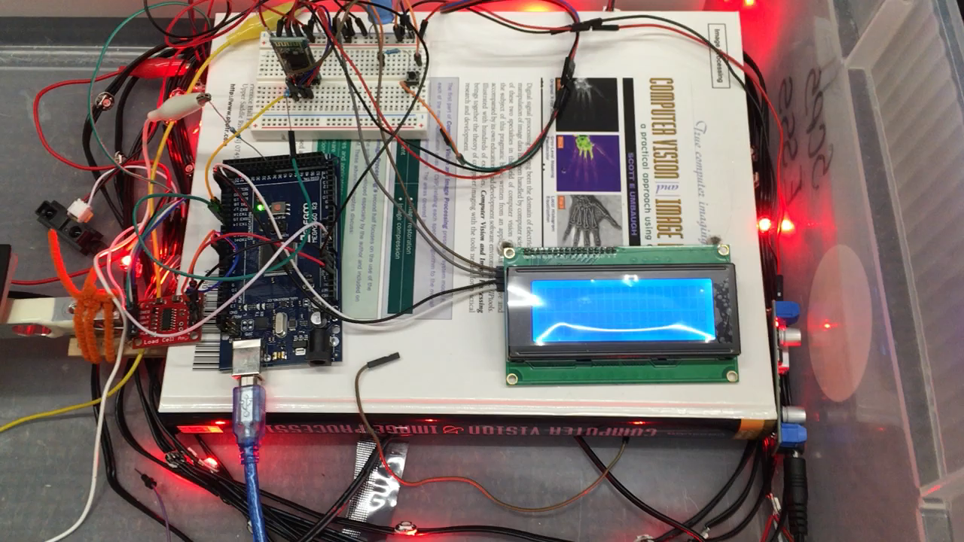
Prototyping Demo
D

Slide 51
Administrative Content
D

Slide 52
Work Distribution
 | Chase | Chris | Dhaval | Mikey
PCB | P | S | T | S
Prototype |  | S | S | P
Main Logic |  | S | S | P
Ambient/Motion | S |  | P | S
UI |  | P | T | S
Bluetooth | S | P |  | S
Signal Lighting | T | S | S | P
Smart Beverage | P | S |  | S
Touch | P |  |  | S
Mobile App |  | P | P
P = Primary S = Secondary T = Tertiary
D
Notes:
Mention that bold things took most effort/involvement across people

Slide 53
Budget
Development Boards | $50
Mouser Components | $150
Prototype (Sensors, LEDs, Buttons) | $105
PCB | $40
Box Construction | $65
Total | ~$410
Mouser components include resistors, photodiodes, LEDs, capacitors, Op-amps, and MCU
Prototype components include IR sensors, photocell, loadcell, smart LEDs, capacitive buttons, and the LCD
D

Slide 54
Progress
D
Notes:
Not finished add our stat, this is another projects stats

Slide 55
Sponsorship Opportunities
Self Funded
Currently In Budget
Working to find sponsor with local restaurants
Any takers?
D

Slide 56
Questions?

